Slide 1
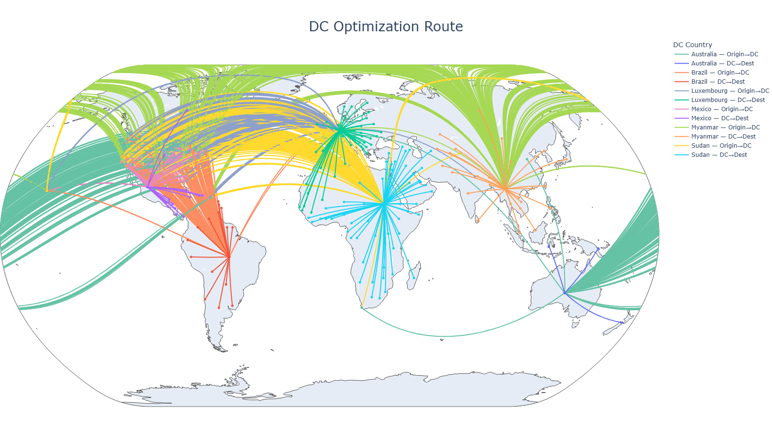
Supply Chain and Cost Optimization:
—----------------------------------------------------
Constante, F., Silva, F., & Pereira, A. (2019). DataCo SMART Supply Chain for Big Data Analysis (Version 5) [Dataset]. Mendeley Data.
Presented by Pornnapas R.

Slide 2
Education
Master of Business Administration
In Industrial Management
Experience
Inventory Planner (from 2023)
Skills
Data Analysis
Visualisation
Machine Learning
Relevance to the project
Stock optimisation
cost modelling
End‑to‑end supply chain
Education
Master of Business Administration
In Industrial Management
Experience
Inventory Planner (from 2023)
Skills
Data Analysis
Visualisation
Machine Learning
Relevance to the project
Stock optimisation
cost modelling
End‑to‑end supply chain
BIO
PORNNAPAS ROONGSUK

Slide 3

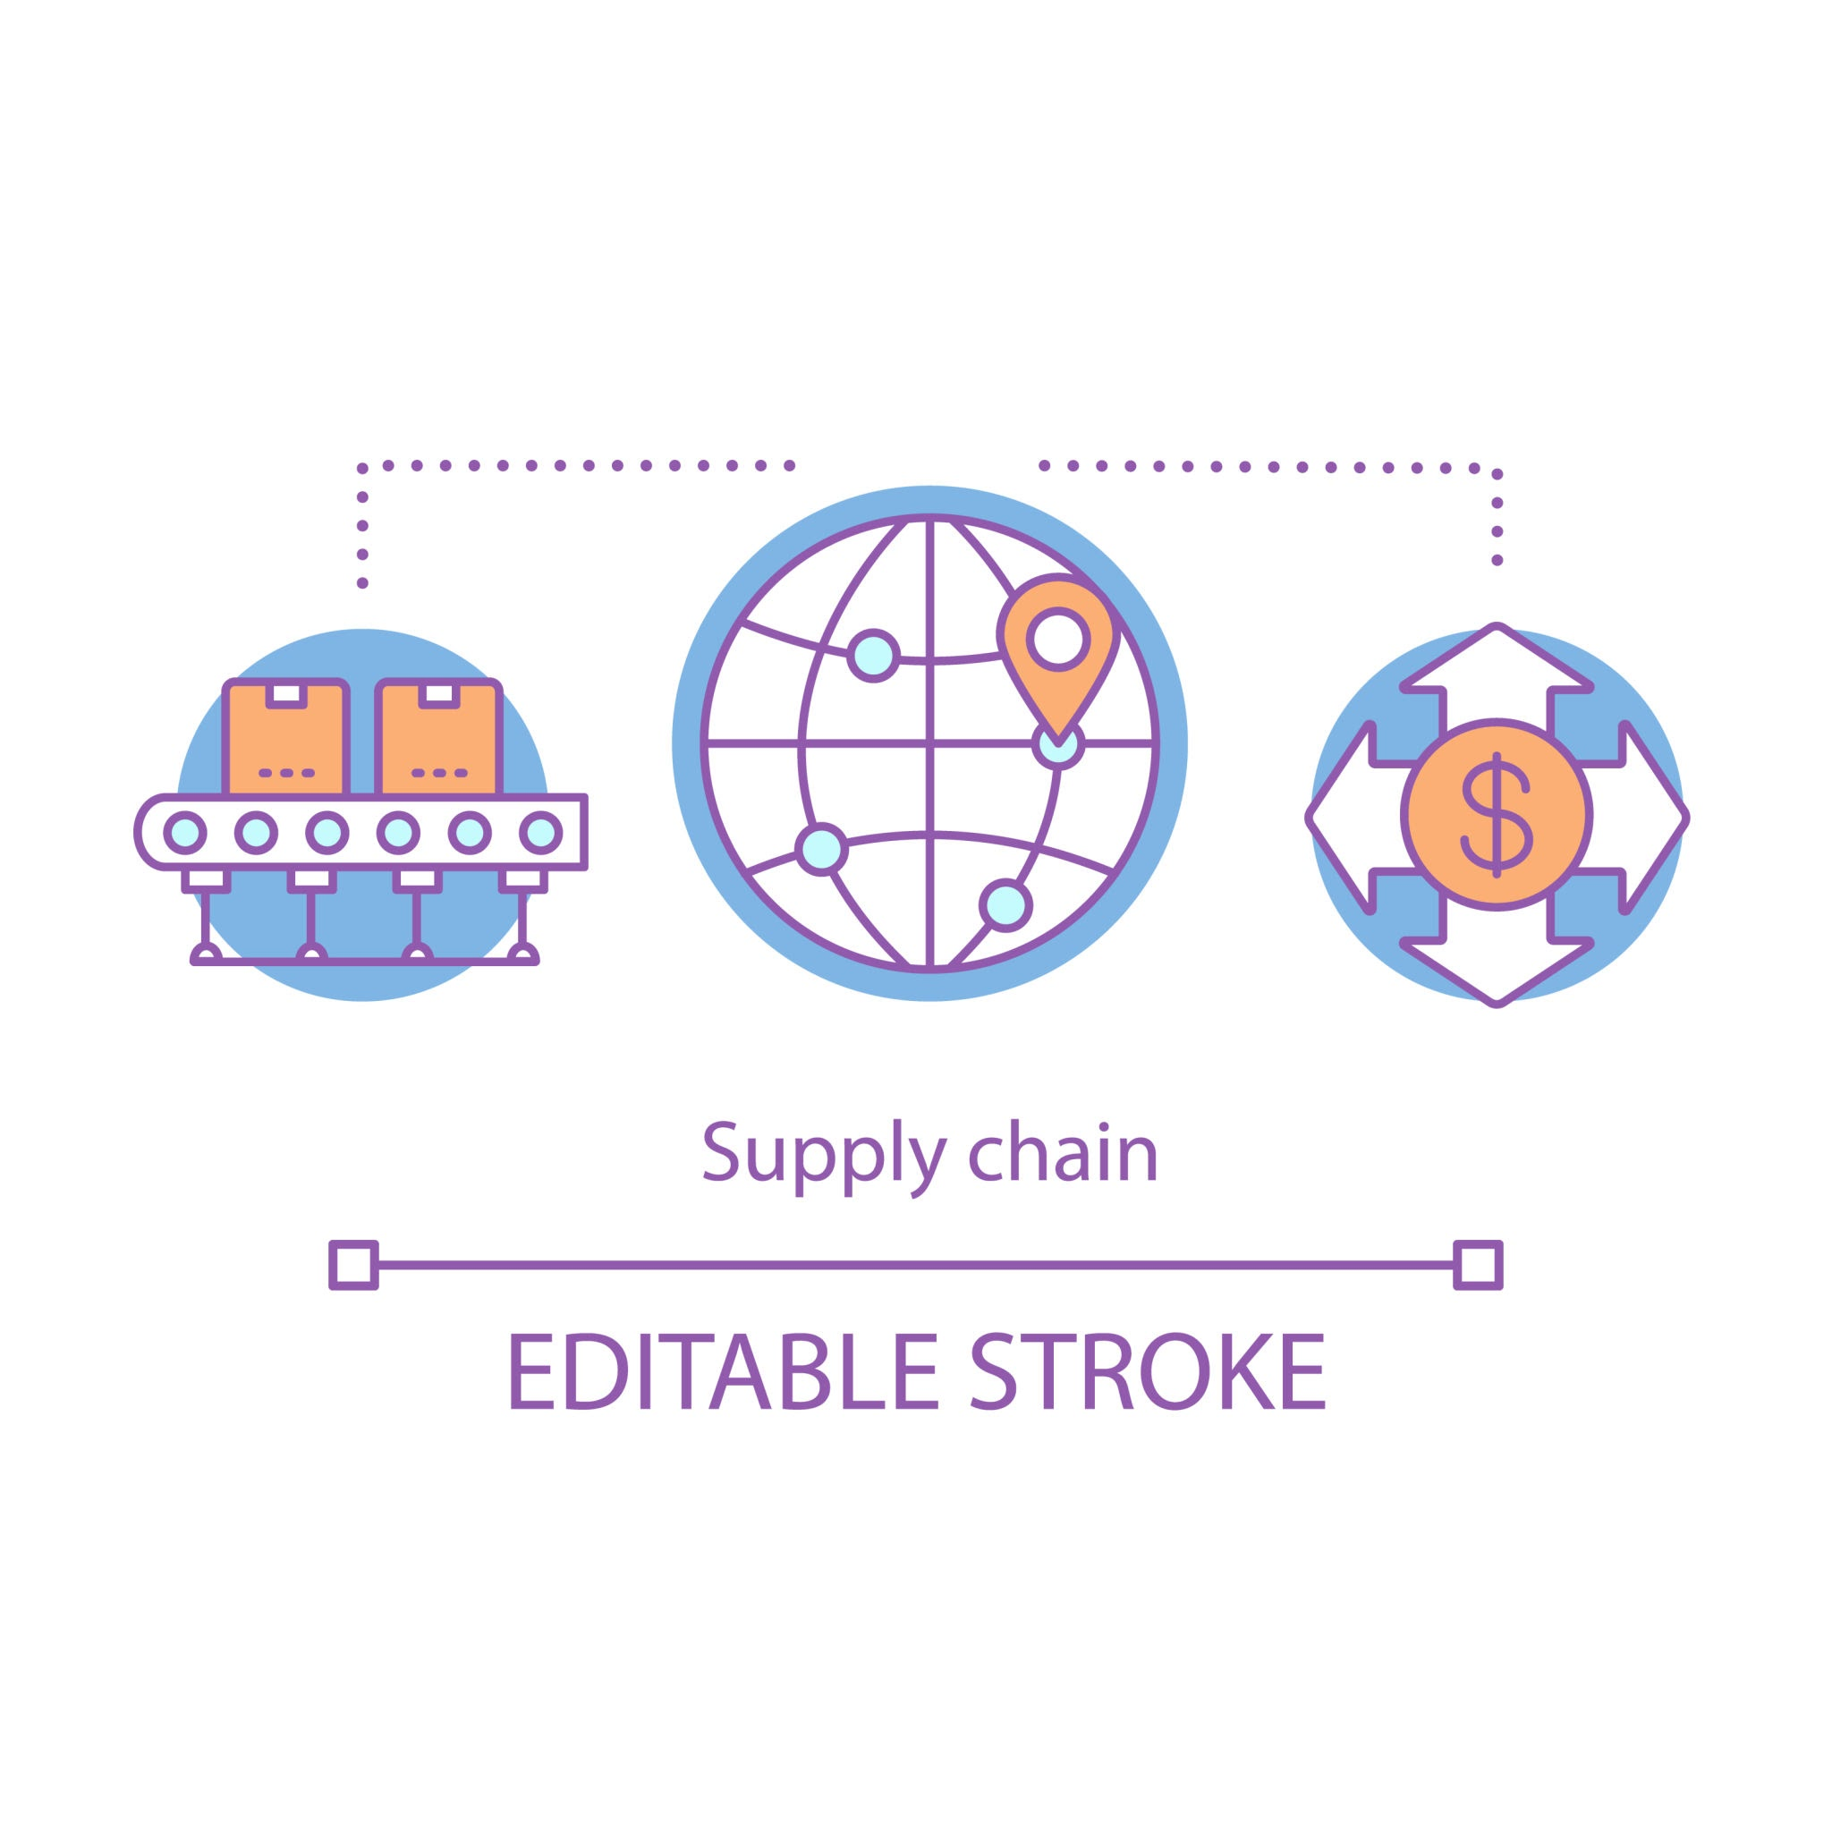
BUSINESS ASPECT
WHO
Stakeholders
WHAT
Core Objective
WHEN
Timing, Report Date
WHERE
Area of Impact
WHY
Desired outcome
Industry - Supply Chain related; Manufacturer, Distributer, Retailer, etc
Internal - Supply Chain, Logistics, Finance, Sales, and Executive teams
External - Supplier, Carriers and distribution partners
Identifying patterns causing transportation delays, high freight cost, and negative margin
Analysing profit ratios, product trends
Highlighting
inefficient route
Based on historical order, freight, and sales data across all available years
Issues occur during order fulfilment, shipping, and delivery cycle
New product or DC implementation
Across all
distribution routes, customer segments, and product categories
Focus on customer quotation
SO creation
Margin Improvement
Reliable On‑Time Delivery
Stable & Predictable Freight Cost
Notes:
1. Solving Real Supply Chain Pain Points
Reducing stockouts, excess inventory, and costly delays.
2. Turning Data Into Smarter Decisions
Using analytics to optimize routes, inventory levels, and service performance.
3. Driving Strategic Business Impact
Improving cost efficiency, customer experience, and global network resilience.
If you want, I can tighten them further or match your slide style.

Slide 4
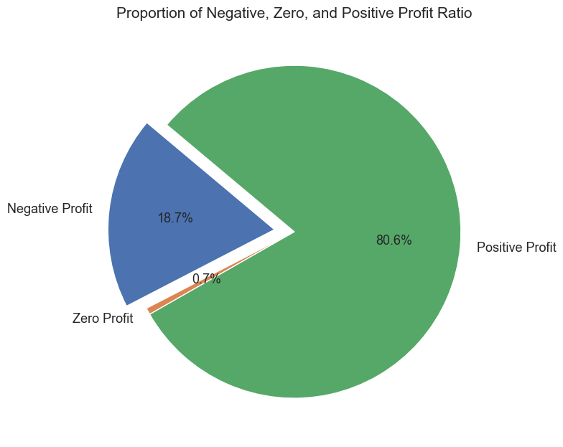
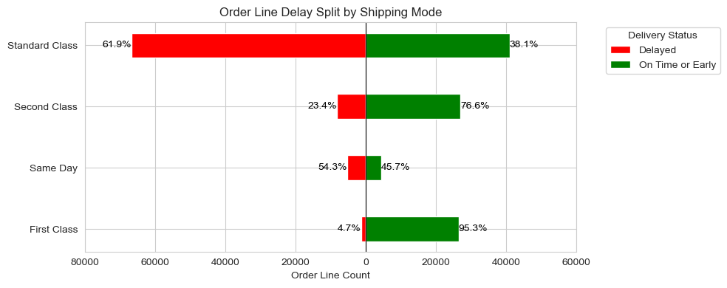
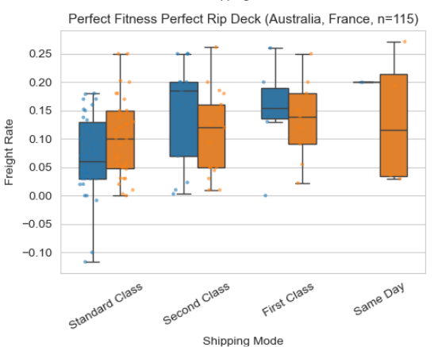
BUSINESS PROBLEM
How can we apply supply chain to reduce transportation delays and cost
while improving delivery reliability and customer satisfaction?
Negative Profitability Margin
Delivery Delays
Unstable Freight Cost
19% of total order showing Negative on profit Margin indicates cost‑to‑serve inefficiencies
Unpredictable lead times
Route‑level variability
Shipping Class inconsistency
Varies freight charge across different shipping routes and shipping modes causing difficulties to predict cost and selling price
Notes:
1. Solving Real Supply Chain Pain Points
Reducing stockouts, excess inventory, and costly delays.
2. Turning Data Into Smarter Decisions
Using analytics to optimize routes, inventory levels, and service performance.
3. Driving Strategic Business Impact
Improving cost efficiency, customer experience, and global network resilience.
If you want, I can tighten them further or match your slide style.

Slide 5
PROJECT METHODOLOGY
BUSINESS ASPECT
5W
How to solve this
BUSINESS PROBLEM
Solutions Suggestions
Data Cleaning & EDA
Feature Engineering
Model Evaluation
Model Implementation
Daily sales:
Range 2015-2018
118 unique products
13 unique origin countries
180,519 rows with Feature:
delivery, customer, product, location information
Define Latitude/ Longitude for Destination and Distribution Center
MODEL1
Late delivery risk prediction
Classifcation model
Late‑delivery risk estimation and comparative delay‑rate analysis for the proposed DC fulfilment mode
KMeans Clustering
MODEL2
Freight charge prediction
Regression model
Interactive Dashboard for pricing estimation
Estimated cost and freight charge
Challenge:
Dataset is Synthetic and have not included actual Cost, Freight charge and Product profile (Life cycle)
Cost calculation to estimate inventory investment
Safety Stock and Re-order point calculation
Notes:
1. Solving Real Supply Chain Pain Points
Reducing stockouts, excess inventory, and costly delays.
2. Turning Data Into Smarter Decisions
Using analytics to optimize routes, inventory levels, and service performance.
3. Driving Strategic Business Impact
Improving cost efficiency, customer experience, and global network resilience.
If you want, I can tighten them further or match your slide style.

Slide 6
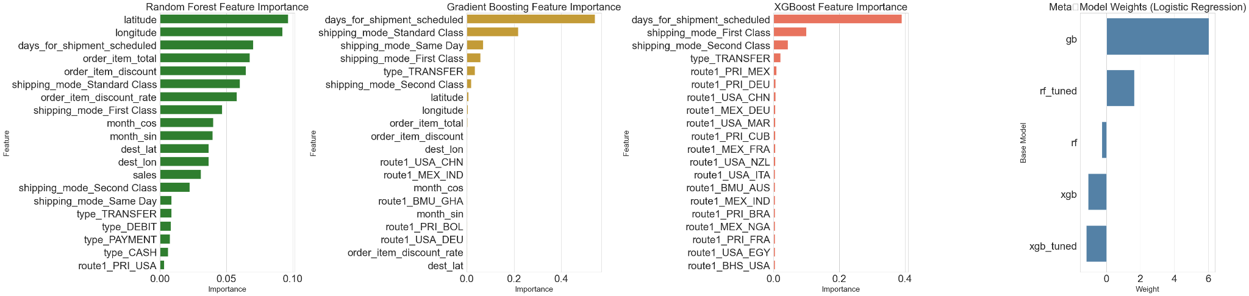
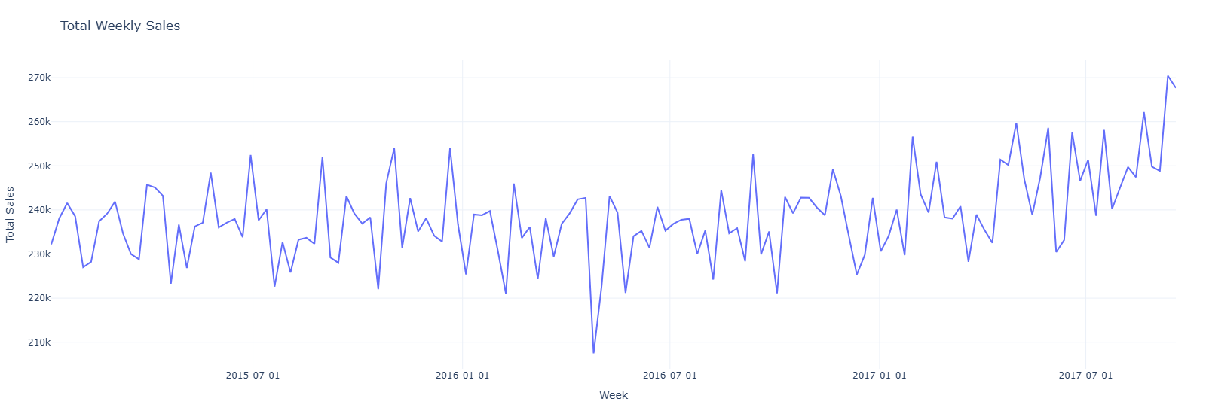
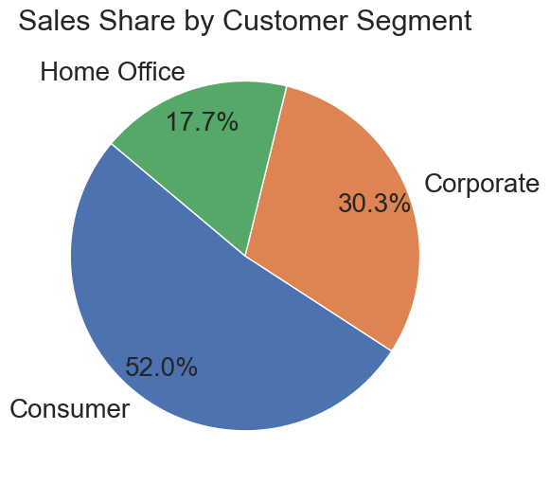
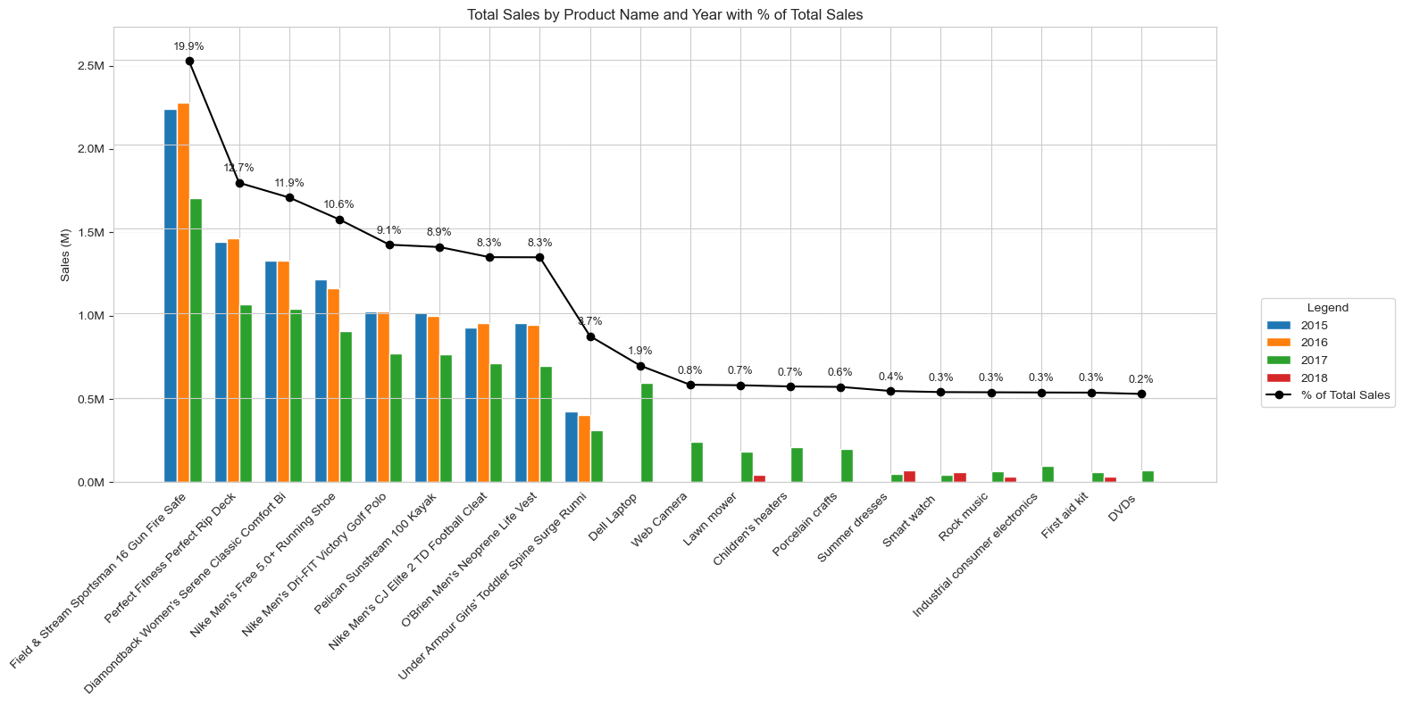
Sales Data History:
Determine product trend with time series data
EXPLORING DATA ANALYSIS
Jan’17
Sep’17
2017 Demand Increase
2017 New Product
Notes:
1. Solving Real Supply Chain Pain Points
Reducing stockouts, excess inventory, and costly delays.
2. Turning Data Into Smarter Decisions
Using analytics to optimize routes, inventory levels, and service performance.
3. Driving Strategic Business Impact
Improving cost efficiency, customer experience, and global network resilience.
If you want, I can tighten them further or match your slide style.

Slide 7
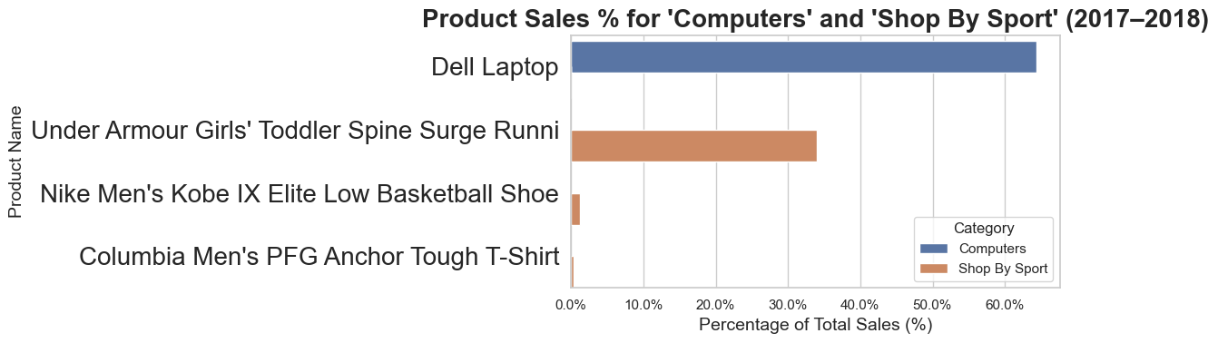
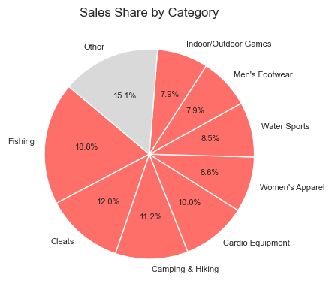
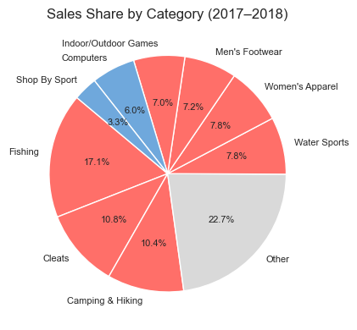
Sales Data History:
Determine product ratio and life cycle
where top segment drive 80% of total sale
EXPLORING DATA ANALYSIS
New product segment on year 2017-2018
Notes:
1. Solving Real Supply Chain Pain Points
Reducing stockouts, excess inventory, and costly delays.
2. Turning Data Into Smarter Decisions
Using analytics to optimize routes, inventory levels, and service performance.
3. Driving Strategic Business Impact
Improving cost efficiency, customer experience, and global network resilience.
If you want, I can tighten them further or match your slide style.

Slide 8
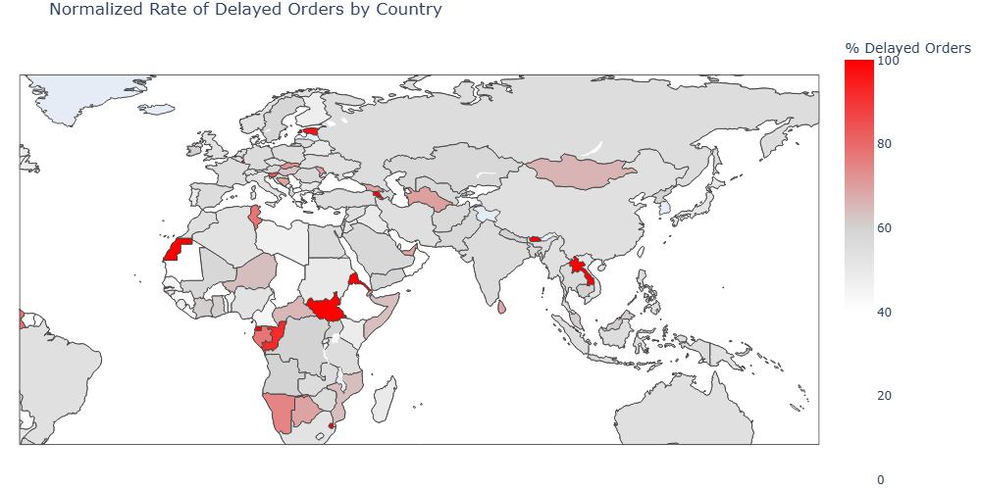
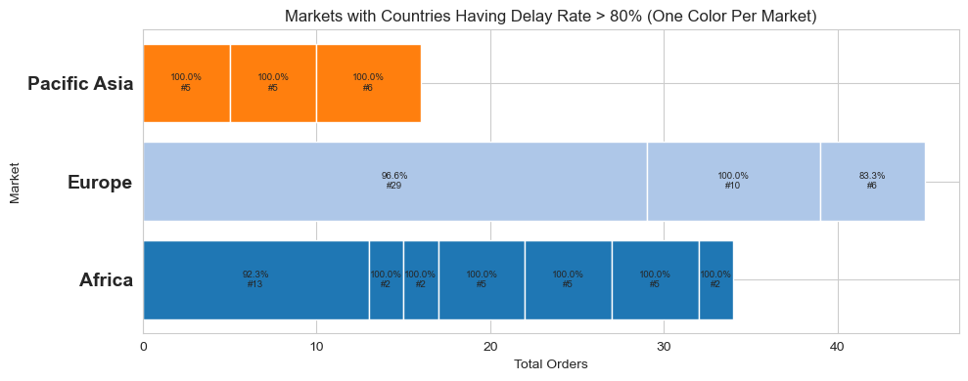
Regional Delays:
High in Europe & Africa markets
EXPLORING DATA ANALYSIS
Europe tends to have highest delay rate
Notes:
1. Solving Real Supply Chain Pain Points
Reducing stockouts, excess inventory, and costly delays.
2. Turning Data Into Smarter Decisions
Using analytics to optimize routes, inventory levels, and service performance.
3. Driving Strategic Business Impact
Improving cost efficiency, customer experience, and global network resilience.
If you want, I can tighten them further or match your slide style.

Slide 9
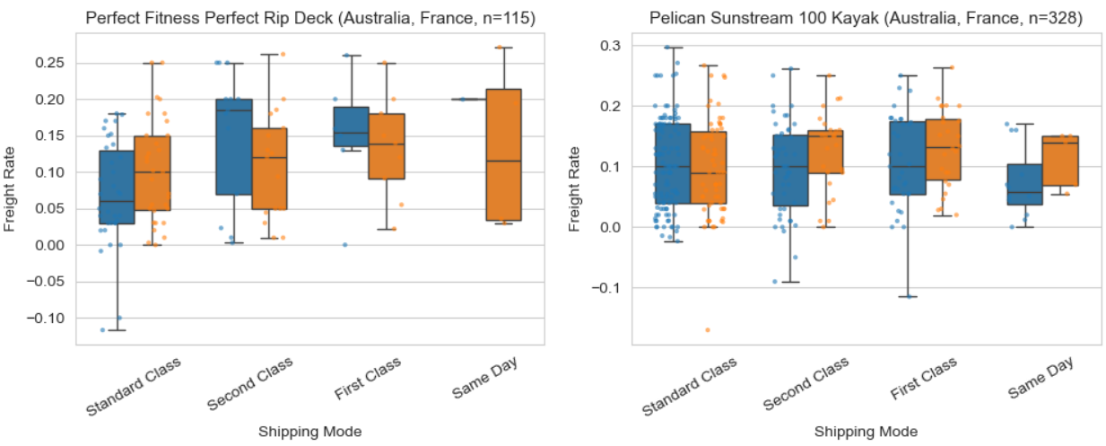
Cost Inconsistency:
Indicates route and shipping mode cost volatility for this product
EXPLORING DATA ANALYSIS
Freight rates vary widely across shipping modes.
Same Day shows the highest cost and largest spread, meaning unstable and unpredictable freight charges.
Standard / Second / First Class are more stable but still show noticeable differences between countries.
Notes:
1. Solving Real Supply Chain Pain Points
Reducing stockouts, excess inventory, and costly delays.
2. Turning Data Into Smarter Decisions
Using analytics to optimize routes, inventory levels, and service performance.
3. Driving Strategic Business Impact
Improving cost efficiency, customer experience, and global network resilience.
If you want, I can tighten them further or match your slide style.

Slide 10
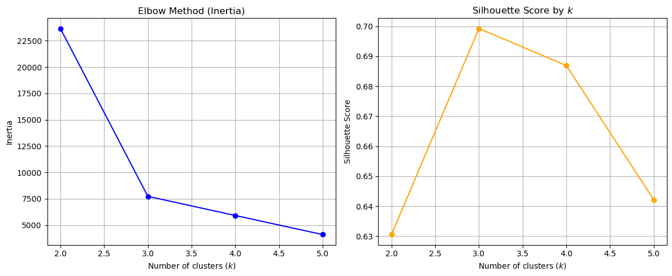

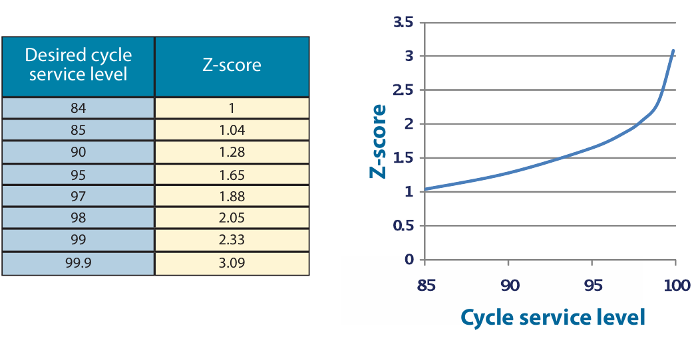
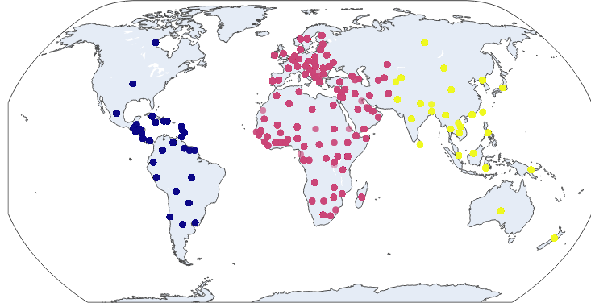
KMeans:
Define 3 clusters from Silhouette score
SafetyStock&
Reorder Point Calculation:
Estimated Stocking Quantity and value
FEATURE ENGINEERING
Notes:
1. Solving Real Supply Chain Pain Points
Reducing stockouts, excess inventory, and costly delays.
2. Turning Data Into Smarter Decisions
Using analytics to optimize routes, inventory levels, and service performance.
3. Driving Strategic Business Impact
Improving cost efficiency, customer experience, and global network resilience.
If you want, I can tighten them further or match your slide style.

Slide 11
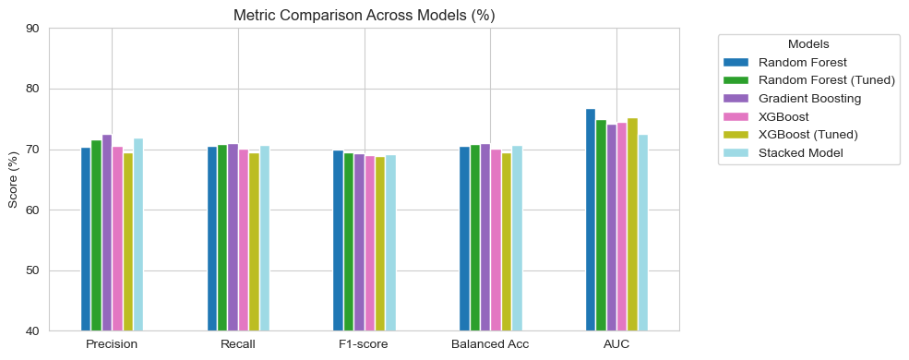
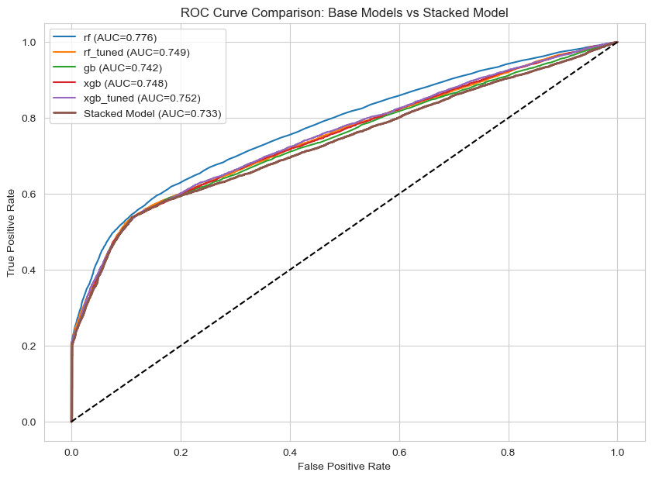
MODEL 1: Late Delivery Risk prediction:
Training model by one product - Location is the main feature impact on the delay
MODEL EVALUATION

Slide 12
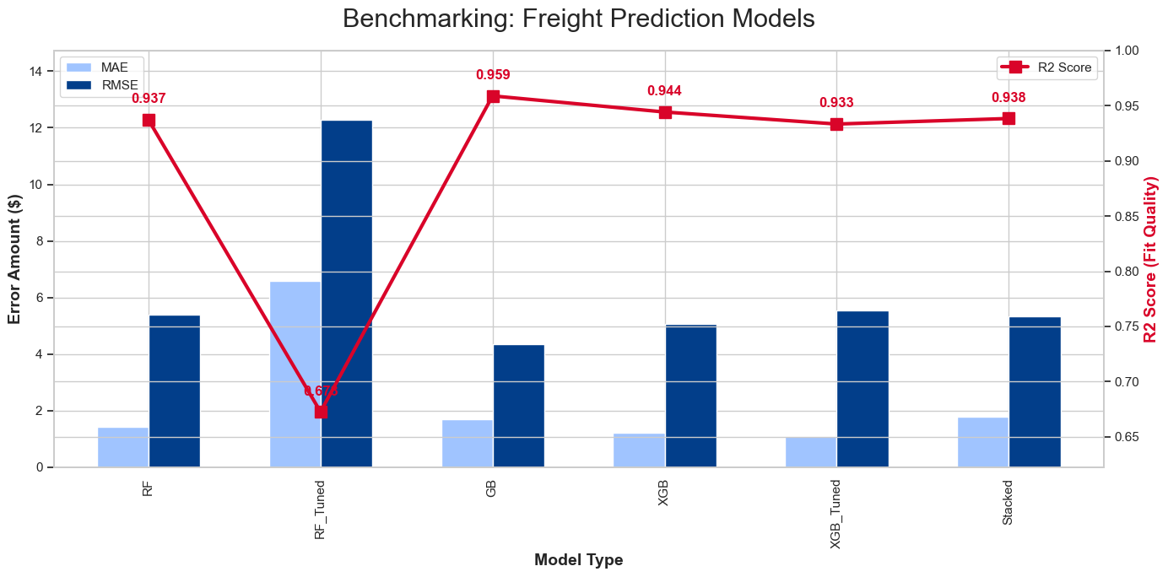
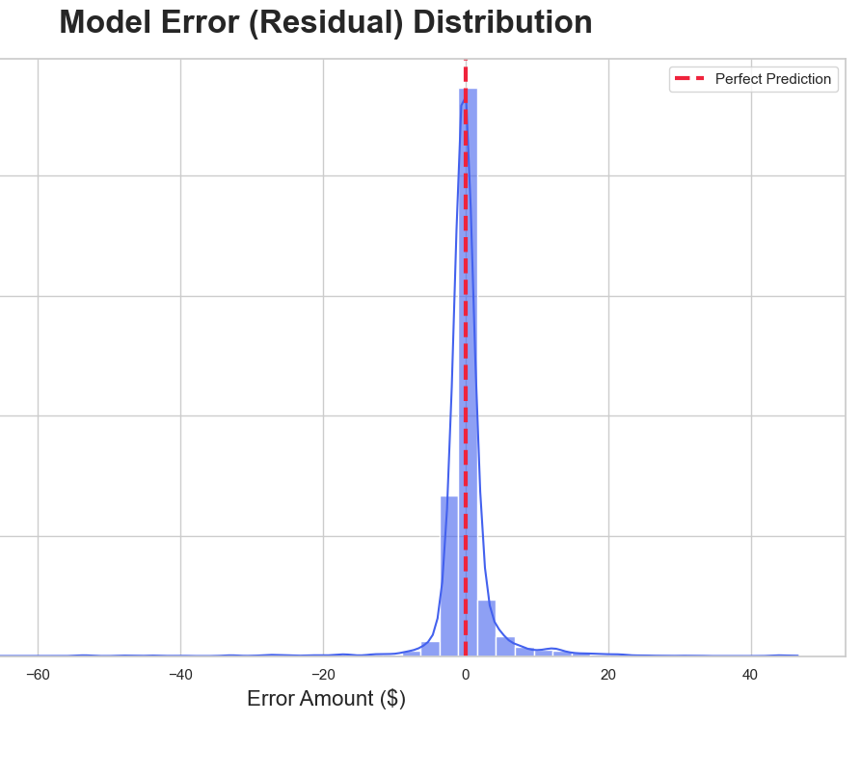
MODEL 2: Freight Charge Prediction
Predict freight charge for estimating investment on DC implementation
MODEL EVALUATION
Residuals are narrowly distributed around zero, indicating high predictive accuracy and minimal systematic bias

Slide 13
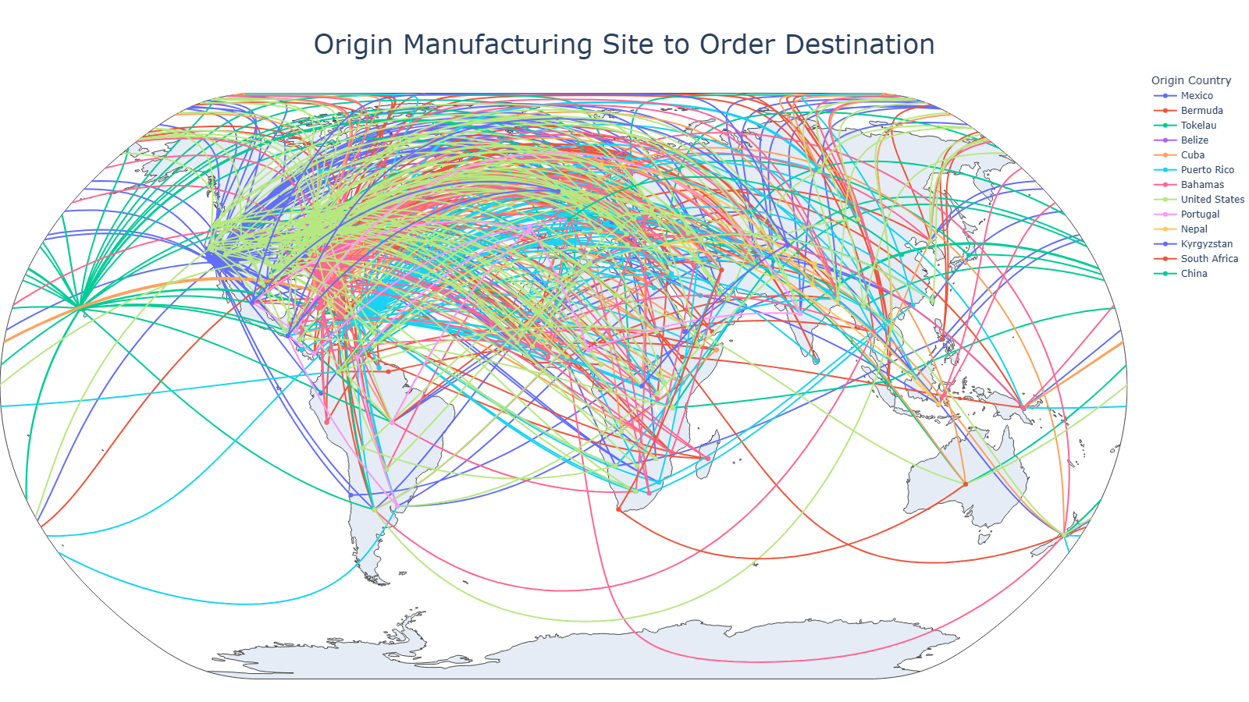
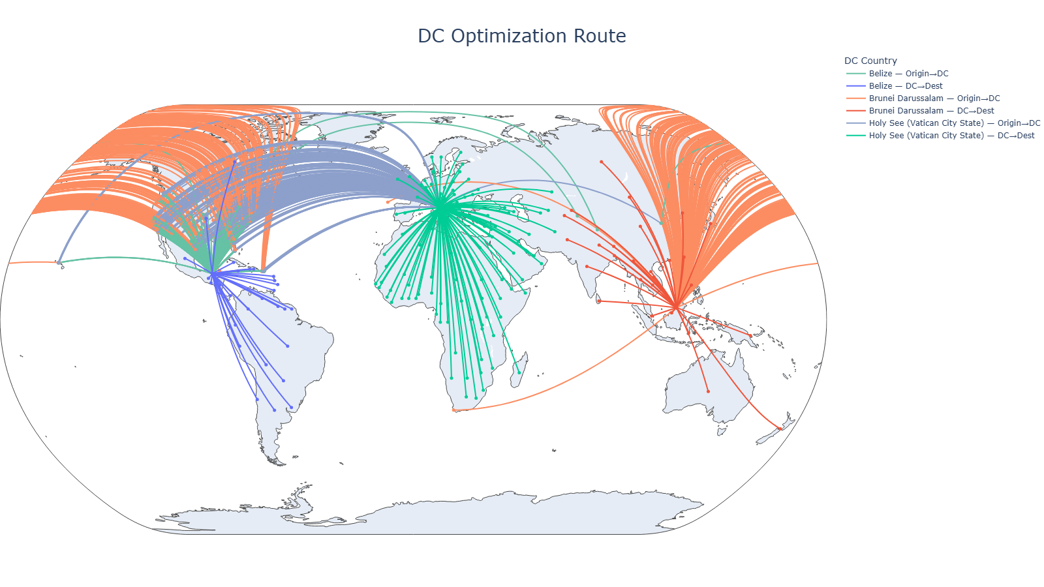
MODEL 1: Late Delivery Risk prediction:
Location Clustering (KMeans) to Determine DC
MODEL IMPLEMENTATION
Current Setting
Distribution Center implementation

Slide 14
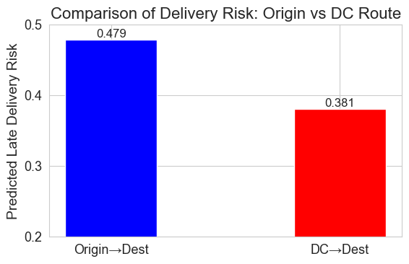
MODEL 1: Late Delivery Risk prediction:
Location Clustering (KMeans) to Determine DC
MODEL IMPLEMENTATION
Prediction result after apply Machine Learning Model
The difference between
the two groups is statistically significant
t-stat: 59.77678496499263
p-value: 0.0
Reduce Late delivery risk
Better route management and Tracking
Ease and Simplify operations progress at Origin
Distribution Center implementation

Slide 15
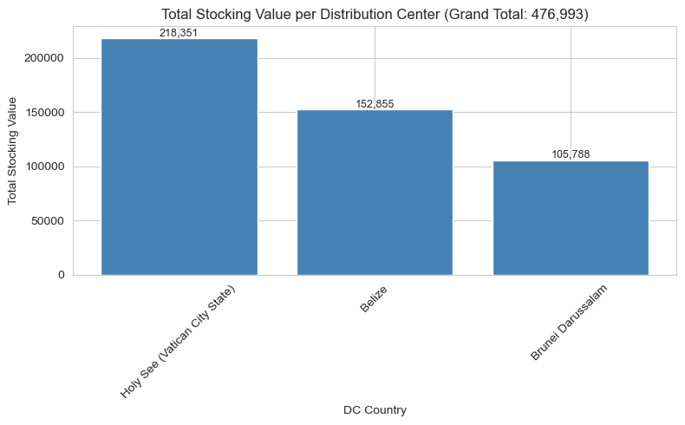
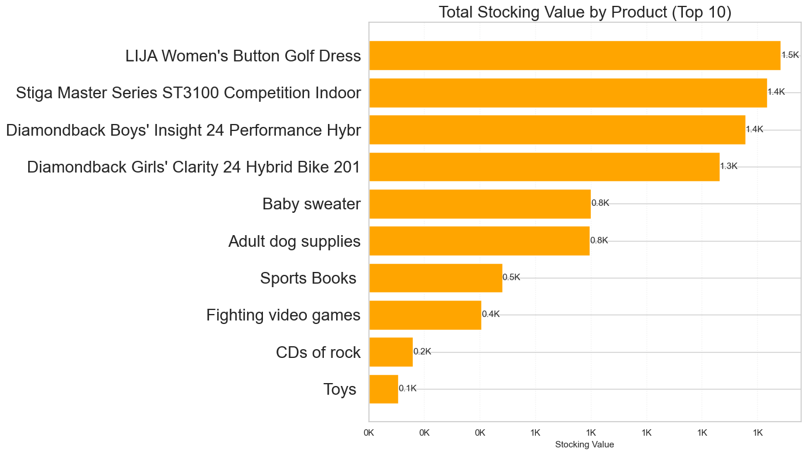
MODEL 1: Late Delivery Risk prediction:
DC Stocking Investment estimation by utilizing reorder point calculation
MODEL IMPLEMENTATION
Total suggested stocking value USD $476K across all new DC
Top product stocking by Value

Slide 16
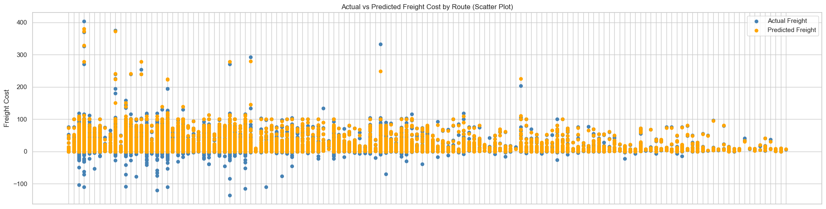
MODEL 2: Freight Charge Prediction:
Apply freight cost prediction model to estimate selling price to improve sale margin
MODEL IMPLEMENTATION

Slide 17
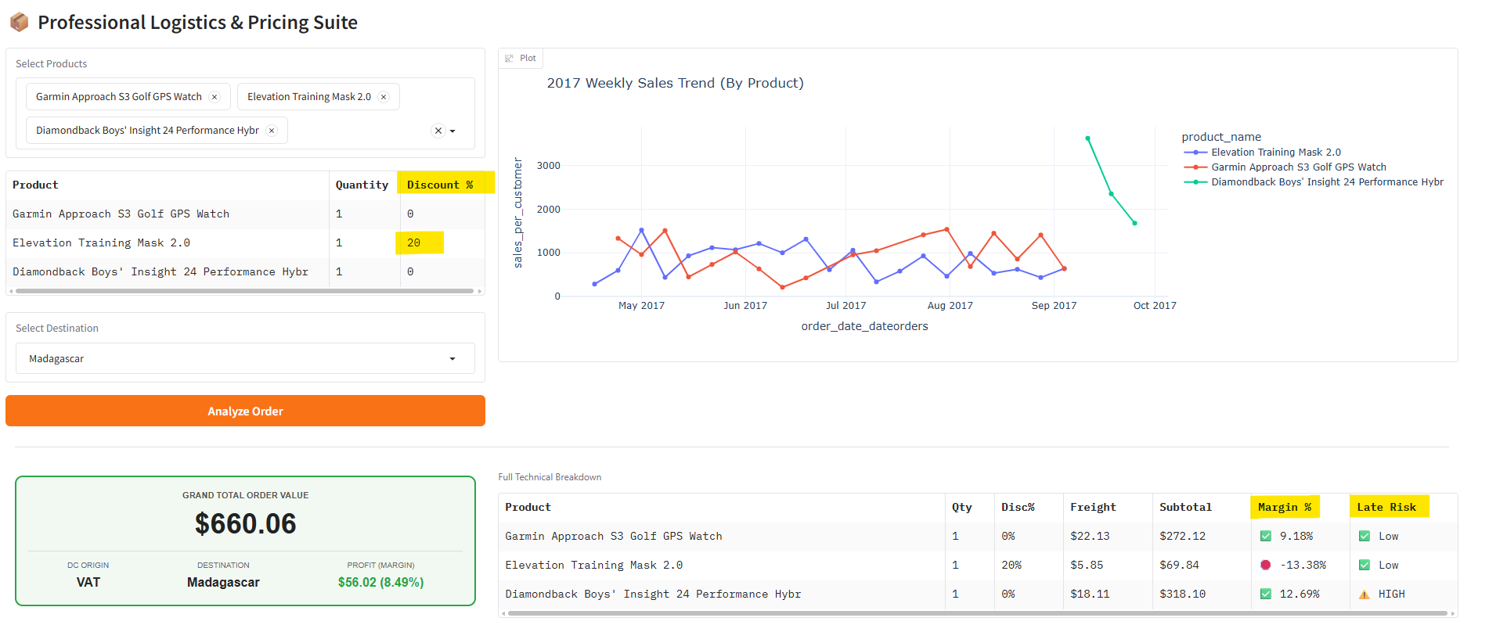
MODEL 2: Freight Charge Prediction:
Gradio
MODEL IMPLEMENTATION

Slide 18
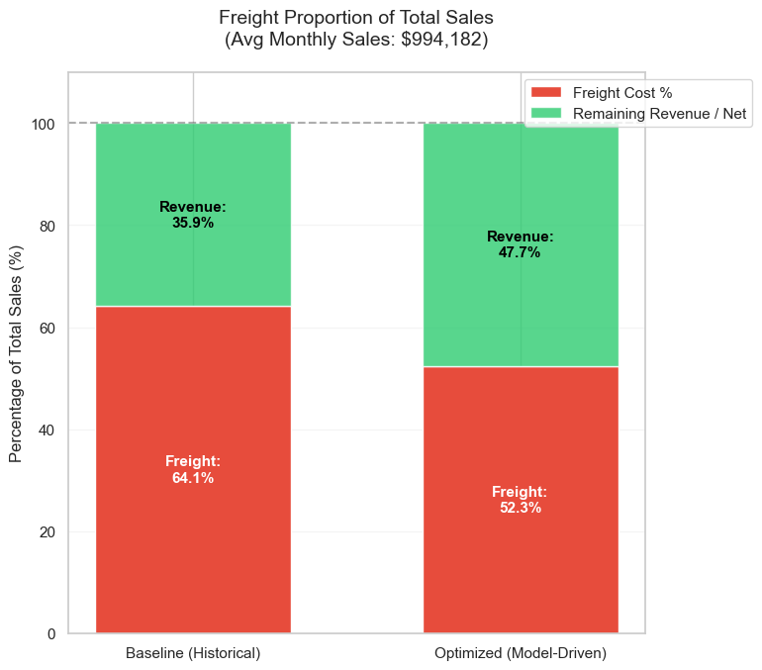
SUMMARY AND CONCLUSION
Negative Profitability Margin
Unstable Freight Cost
Delivery Delays
MODEL 1:
Implement DC and Inventory Optimization
Operations, Supply Chain
MODEL 2:
Product Sales Driven
Sales, Pricing, Marketing
Reduce 20% of Delayed risk
by Implement DC fulfilment
Dropped monthly freight-to-sales ratio by reclaiming more revenue 11.8% of total sales while providing precise cost estimations for the stakeholder
Focusing on sale strategy by Top sale product which cover approx 80% sales and implement Product Life Cycle
S O L U T I O N S
Cost trackers: Log every freight charge and actual expense to keep profits accurate.
Set Up Regional Hubs: Choose the best DC in each area to keep shipping smooth and fast.
Regional and Domestic Logistics operations: Gather more data for better delivery prediction result
N E X T
Notes:
1. Solving Real Supply Chain Pain Points
Reducing stockouts, excess inventory, and costly delays.
2. Turning Data Into Smarter Decisions
Using analytics to optimize routes, inventory levels, and service performance.
3. Driving Strategic Business Impact
Improving cost efficiency, customer experience, and global network resilience.
If you want, I can tighten them further or match your slide style.

Slide 19





THANK YOU
CONTACT
https://www.linkedin.com/in/pornnapas-roongsuk/
r.phornnapas@gmail.com
+61 479 149 245
https://github.com/rphornnapas/DataCo-SupplyChain-DC
https://huggingface.co/spaces/smilesimile/DataCo-SupplyChain

